Slide 1
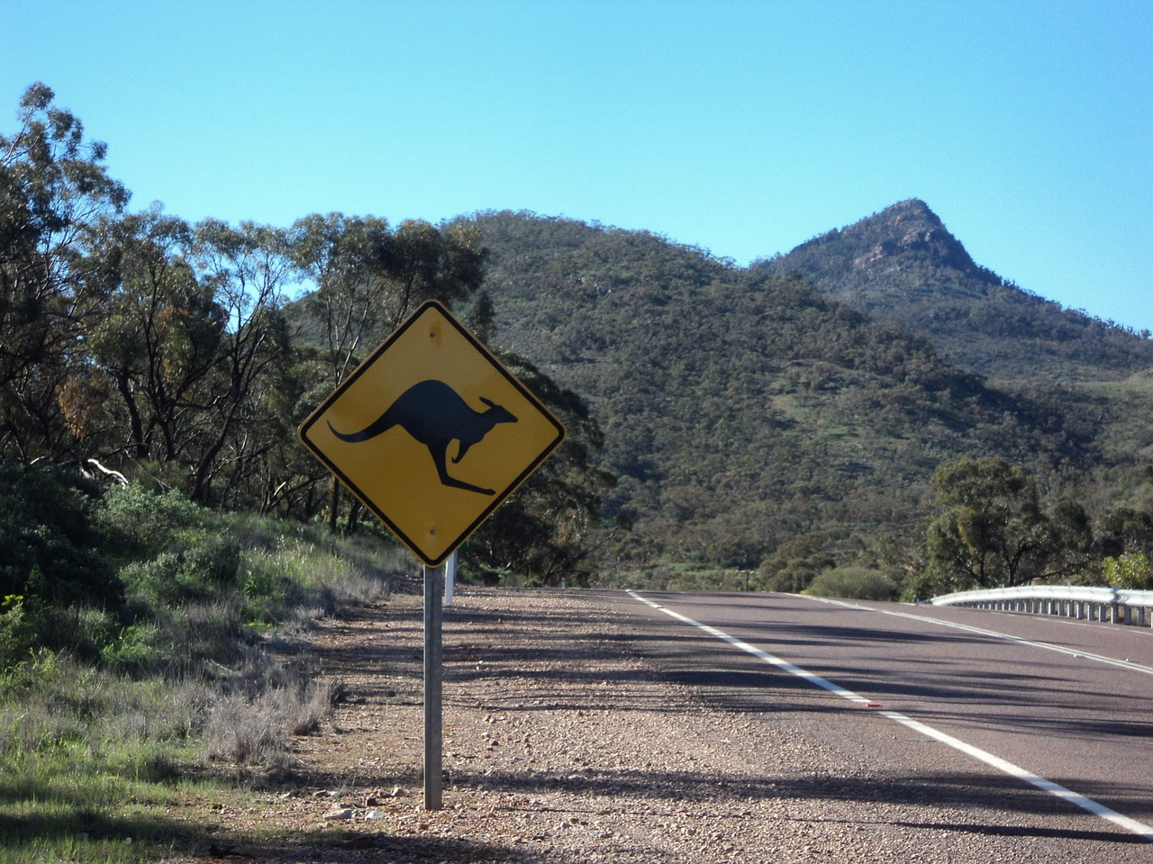
Honey I Hit A Roo!
Reducing The Impact of Wildlife Injuries

Slide 2
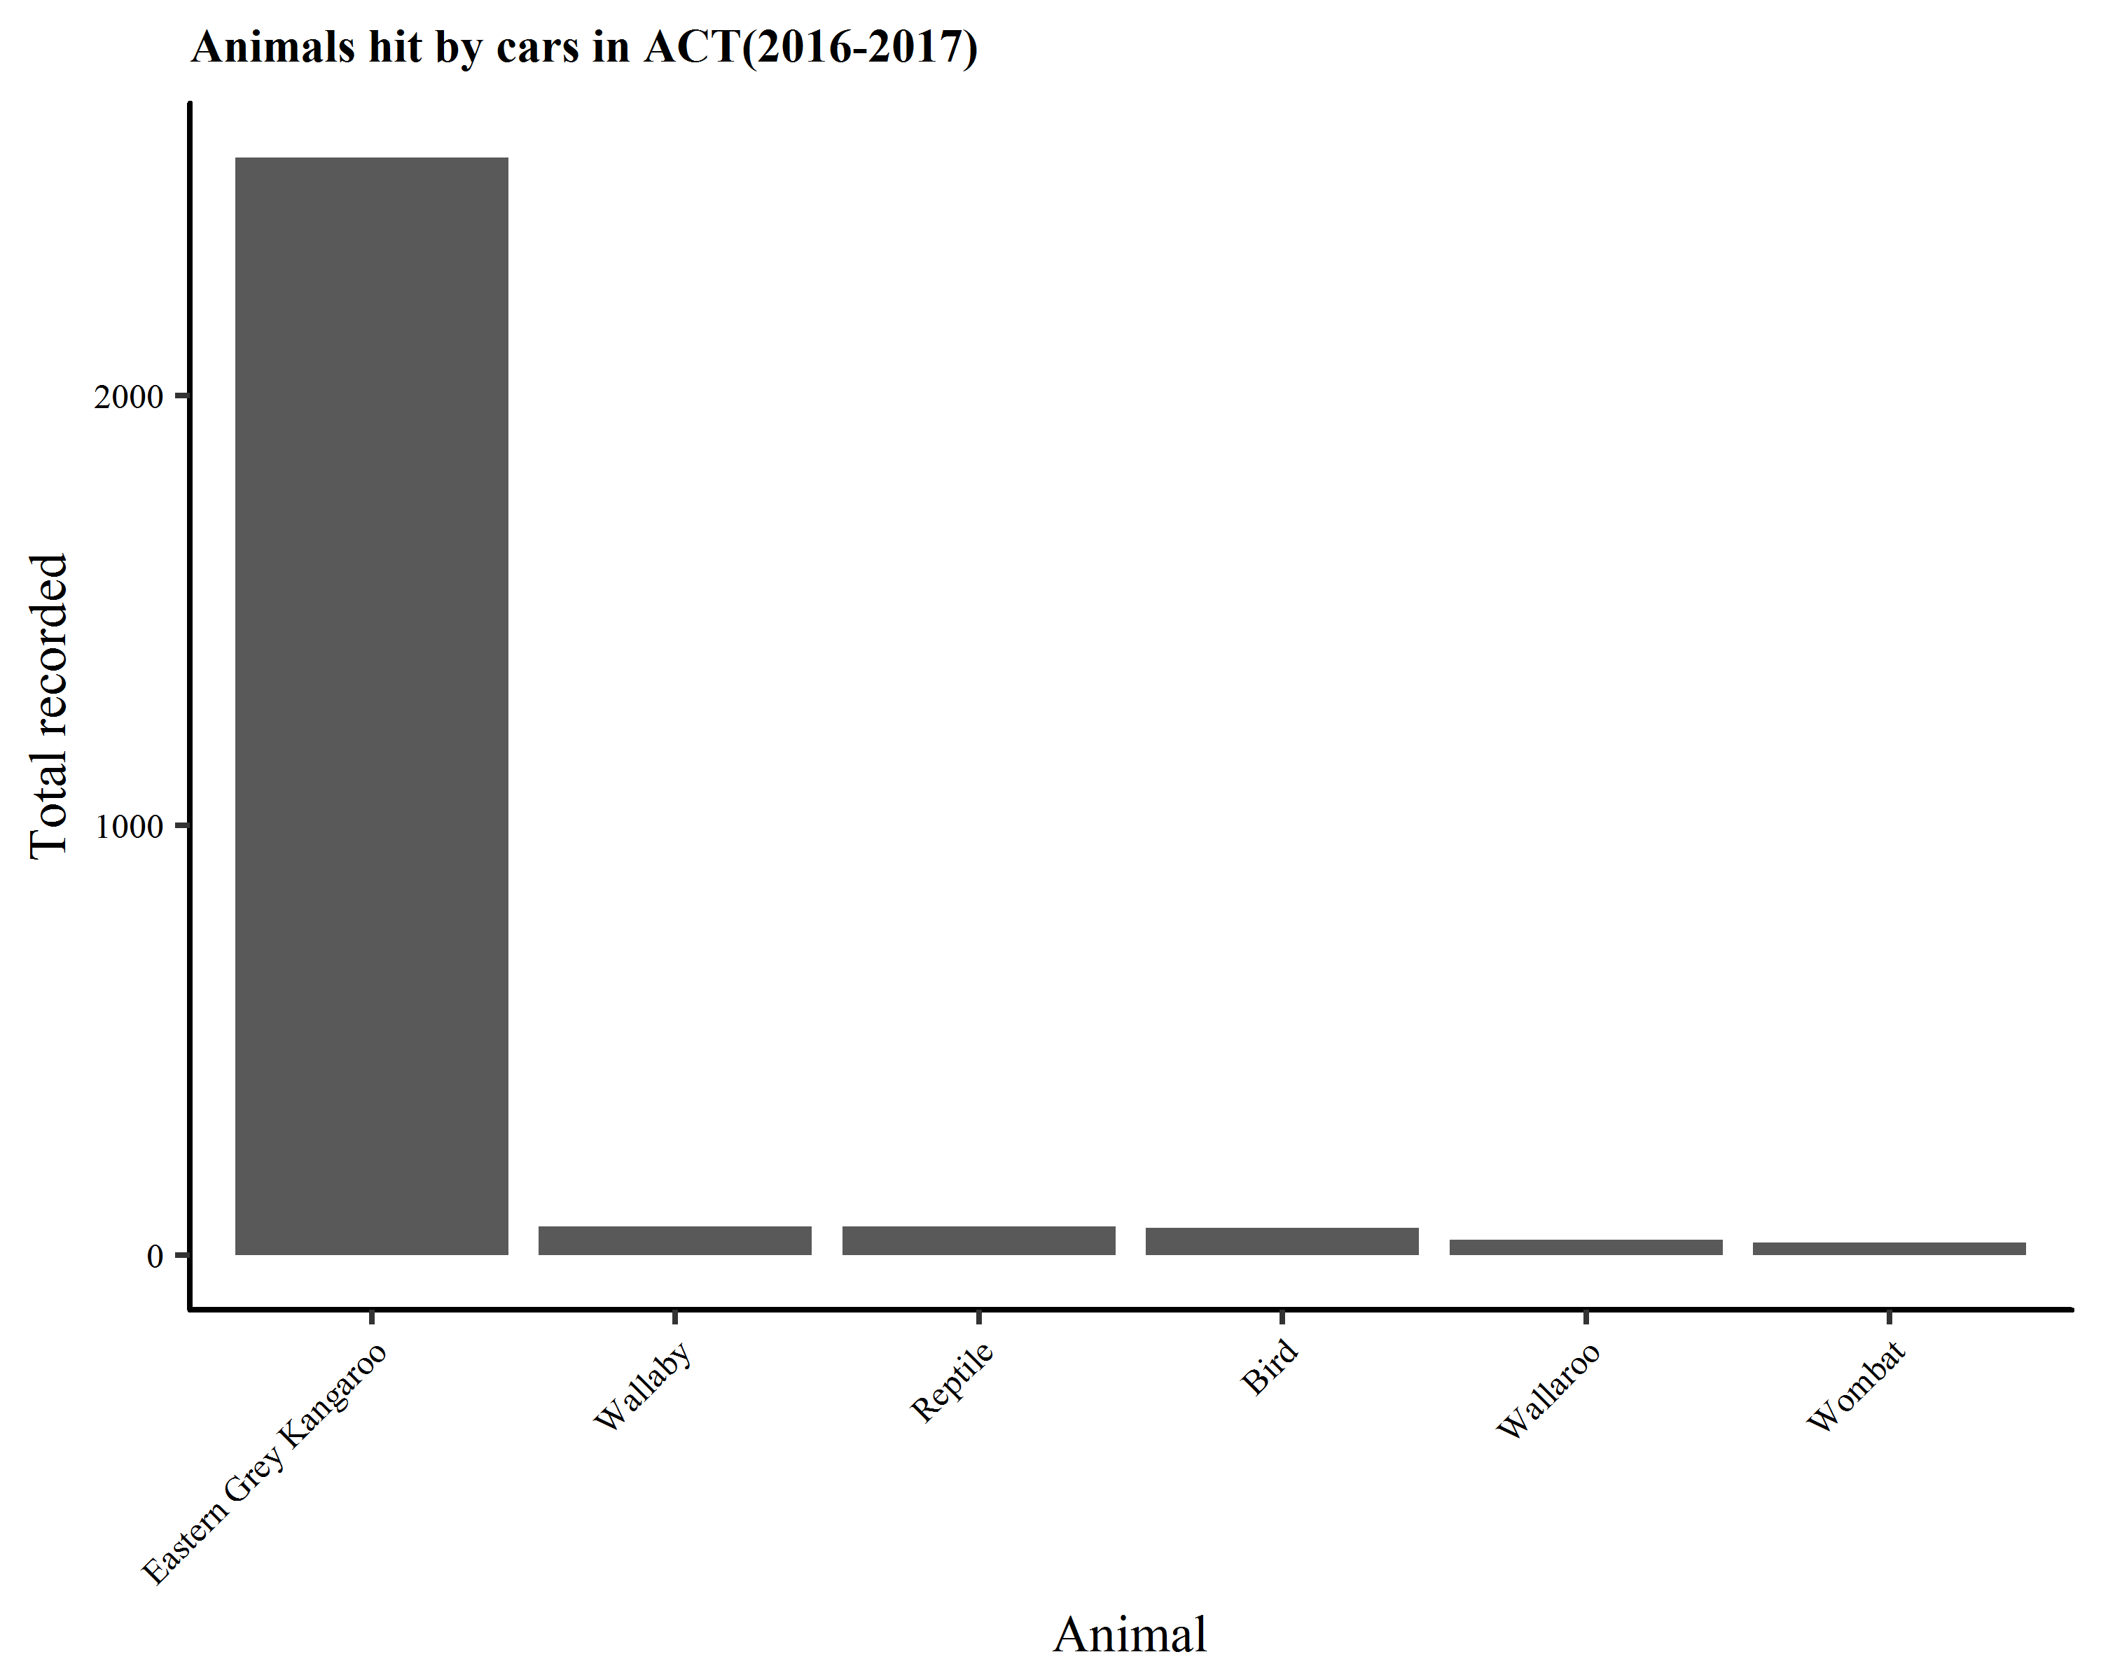

Slide 3
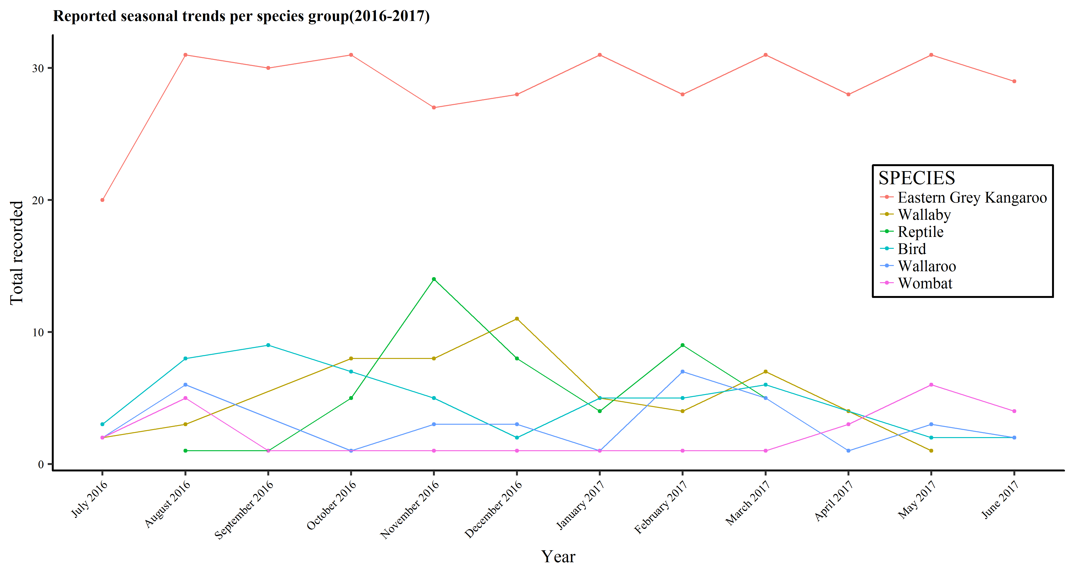
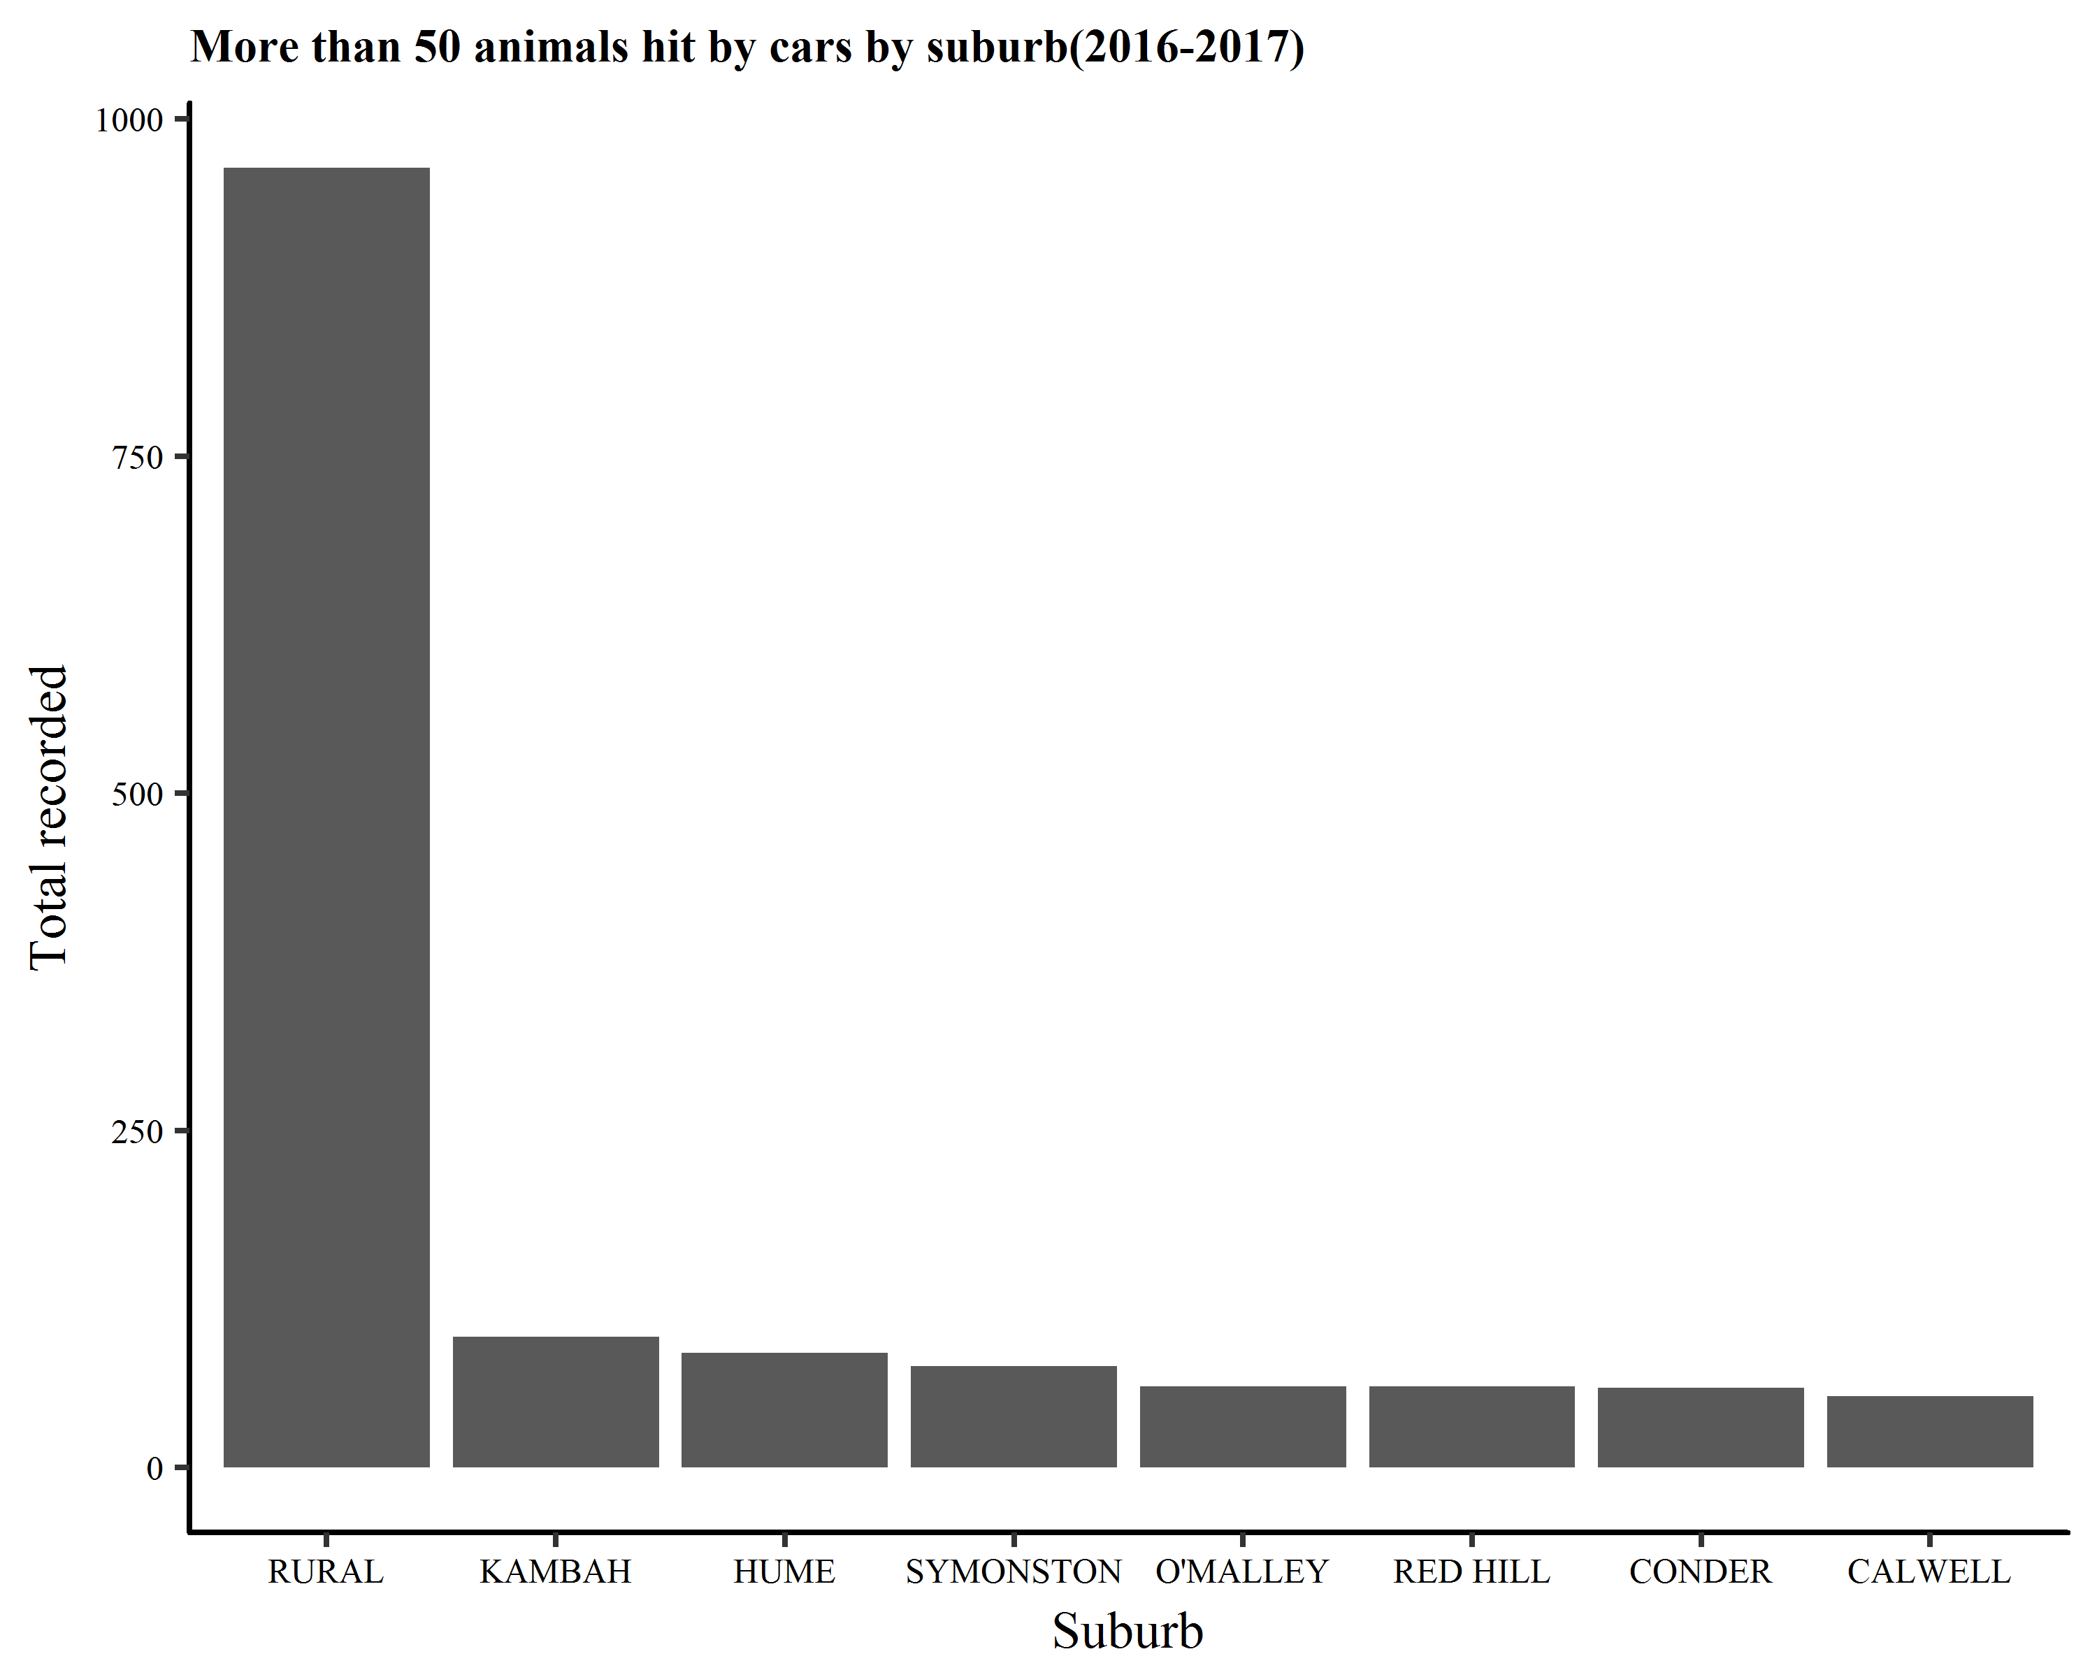
Australian Wildlife Problem
Animals Not Good With Road Rules
86,000 Native Animals killed p.a.
Almost 90% are Kangaroos
Often go unreported
Poor data quality

Slide 4
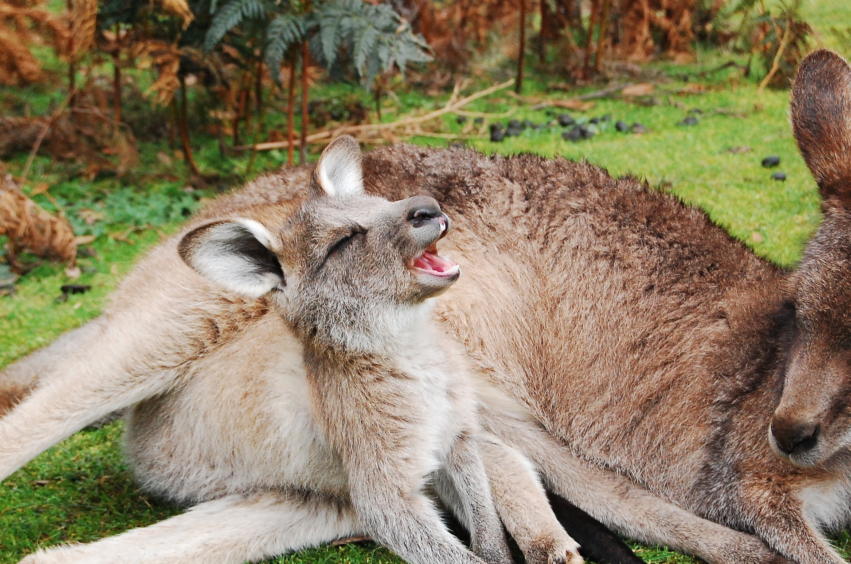
Solution
Better data capture
Incentive to report
Ease of reporting
Simultaneously report

Slide 5
How it Works

Slide 6
User Benefits

Slide 7
Government (Analysis) Benefits
Multiple NEW sources of data
Quantify observer bias
Model and integrate high quality transport and public use data
Up to date user mapping for hot spots of animal use

Slide 8
Global Impact
Better analysis of effective mitigation methods
Employ technology to avoid collisions
Map data into GPS Nav systems.

